Slide 1

Purchase Intention of Online Shoppers
Matthew Keenan, Manjot Kaur, Hina Sherwani
Notes:
Hello, this is the presentation for Group 6 for BIT 5534, which consists of: Matthew Keenan, Manjot Kaur, and Hina Sherwani. The intent of this presentation is to help understand the intentions of online shoppers for a given business. Over the next few slides we will go through the business problem along with the different models used and their results and finally, the conclusion of which model we suggest the firm can use to best predict the purchasing intentions of customers.

Slide 2
Business Problem
What is conversion rate optimization?
The process that businesses undertake to increase the number of conversions on their websites.
How can we increase conversion rates?
Identify which variables have significance on the probability that a user will make a purchase
Form predictions about future purchases
What is the long-term goal?
Enhanced predictive analytics leads to increased revenue and profit
Key factors of e-commerce determined that contribute to optimal conversion rates
Notes:
The business problem we aim to answer can be found amongst the following questions.
While the data presented is not specific to a particular company, the attributes collected and analyzed in this report are commonly collected website metrics and dimensions.
Should the results prove significant, they will not only enable a business to form better projections for revenue and profit, but will also identify specific elements of the e-commerce process that are most important in determining whether a user converts or not.

Slide 3
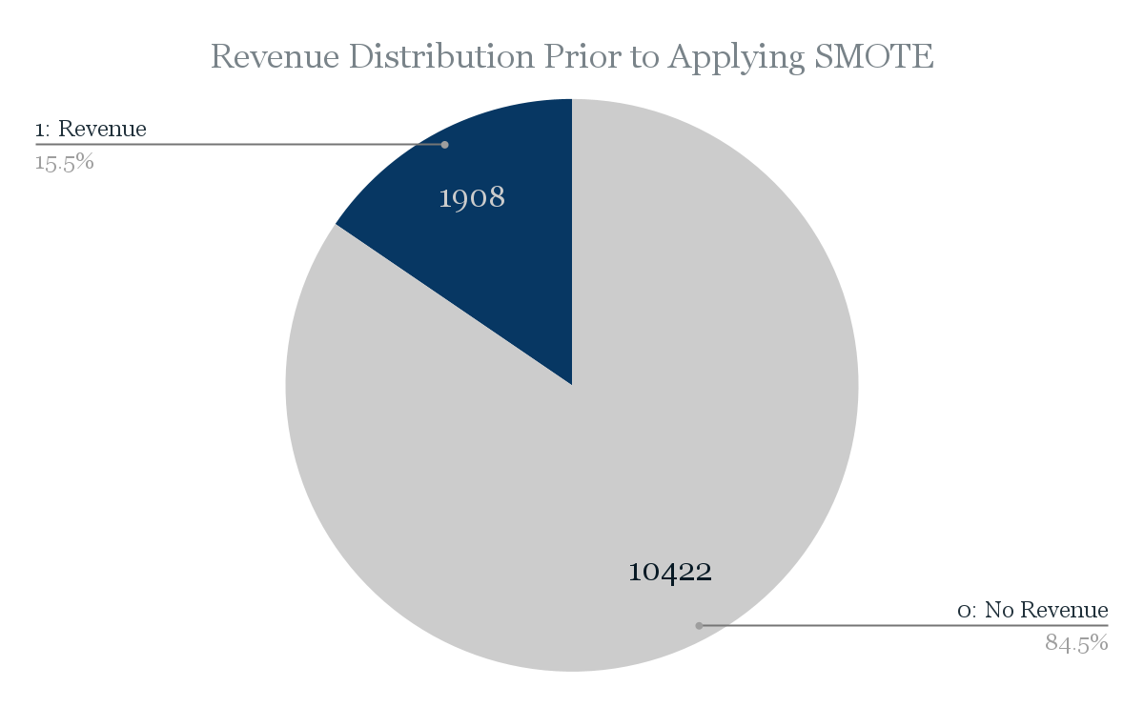
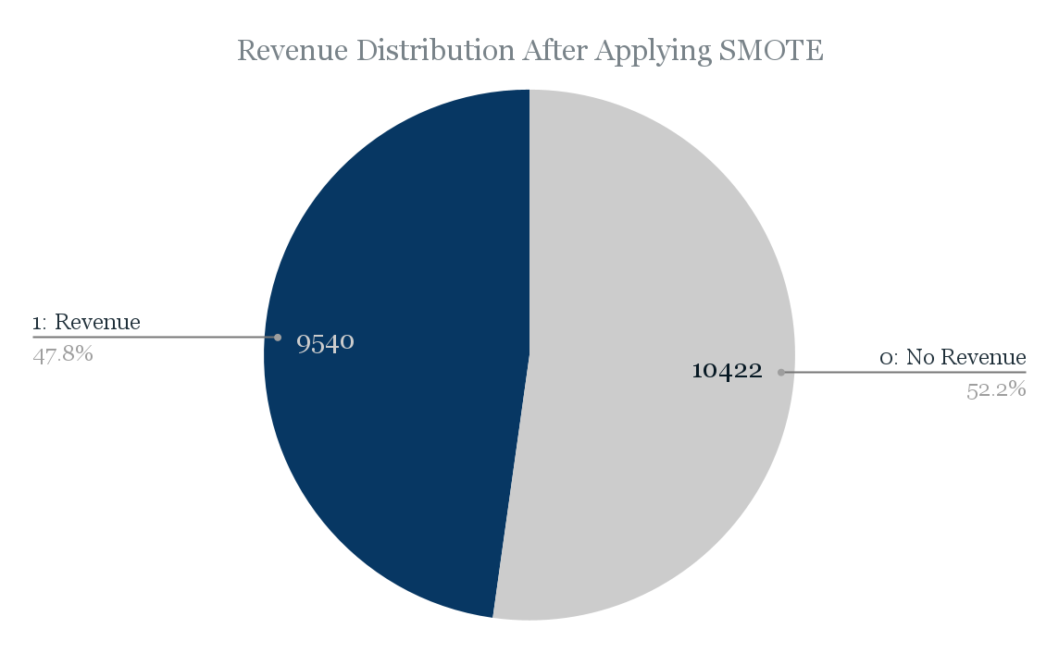
Data Overview and Preparation
Source
The UC Irvine Machine Learning Repository
Dataset
12,330 records, 18 attributes
Target
Revenue (1: Purchase Made in Browsing Session)
Predictors
Page-Type Variables: Administrative, Informational, Product-Related
Visitor-Type Variables: New, Returning, Other
Calendar Related Variables: Month, SpecialDay, Weekend
Session Related Variables: Administrative_Duration, Informational_Duration, Product-Related_Duration, BounceRates, ExitRates, PageValues
- Network Related Variables: OperatingSystems, Browser, Region, TrafficType
Preparation
Convert nominal variables into numerical or boolean values
Apply SMOTE to address uneven distribution of target variable
SMOTE
Notes:
The dataset for this project is available via the UC Irvine Machine Learning Repository found at this link under a Creative Commons license (CC BY 4.0). The dataset contains 12,330 tuples, each with 18 attributes. The target variable in the dataset is labeled “Revenue” and it is a binary variable set to either display “True” if a purchase was recorded for the browsing session described in the current row, or “False” if there was not a purchase in the session. The dataset contains no null nor missing values and requires minimal preparation before exploratory analyses.
In order to prepare the data for analysis, we performed some basic data preparation. We identified four nominal variables: Month, Visitor Type, Weekend, and Revenue. For each of these variables, we implemented a strategy to convert the text value into numerical or boolean values. We split the ‘Visitor Type’ variable into 3 variables with boolean values. This results in a total of 20 attributes of which 15 are numerical and 5 are categorical. Of the 15 numerical values, 7 are continuous and 8 are discrete. All 5 categorical variables are nominal as they have boolean values.
The goal of this project is to form accurate predictions for user conversions, so the ‘Revenue’ variable will serve as the ground-truth value for us to compare the results of our predictions against. Thus, ‘Revenue’ is our target variable and the boolean value is 1 if revenue was generated in that user session. The remaining 19 variables are our predictor variables. We will be using the predictor variables to determine if certain page types (Administrative, Informational, or Product-Related), duration on each of these types of pages, bounce rate, exit rate, the value of the page, whether the current day is a holiday, the current month, operating system, browser, region, traffic type (organic, direct, paid, etc.), visitor type (new, returning, other), and whether the current day is a weekend day or not can all lead to accurate predictions for whether a user may convert into a paying customer.
With the dataset identified, we then performed data exploration before building any data mining models. The most notable finding of this exploratory analysis is the presence of a heavy class imbalance within the target variable, seen in Figure A-1 within Appendix A. Out of 12,330 rows, 10,422 rows (85%) have a 0 value in the target (no conversion), while only 1,908 (15%) have a value of 1 (conversion). Such an uneven distribution can cause inaccurate results due to many data mining and machine learning processes developing biases towards the dominant class in the target variable. Therefore, to combat class imbalance in this project, we adopted SMOTE, Synthetic Minority Over-sampling Technique. SMOTE is a form of oversampling that uses KNN algorithm to create artificial data from the minority class until the weights of the values in the target class become roughly equivalent. In return, the total number of rows increases, however the value distribution in the target variable becomes much closer to an even split than the distribution of the target in the original dataset.
We utilized a JMP add-in for SMOTE available free for users with a JMP license here. Figure A-2 in Appendix B illustrates the results of applying SMOTE to the dataset. Note that the total number of records in the dataset increased from 12,330 to 19,962, and the value distributions are nearly equal. The count of rows with a “0” value for Revenue remained exactly the same at 10,422, but the rows with “1” as the value for Revenue increased from 1,908 to 9,540. Now, instead of an 85%-15% split in the target variable, we now have a 53%-47% split. This will mitigate potential risk and bias from any of the data mining methods we will develop from the data.
3 mins and 3 seconds

Slide 4
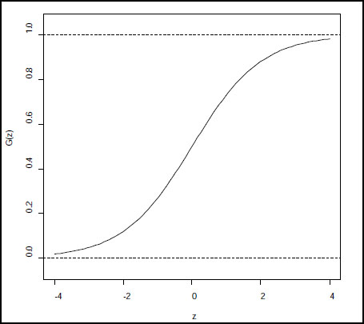
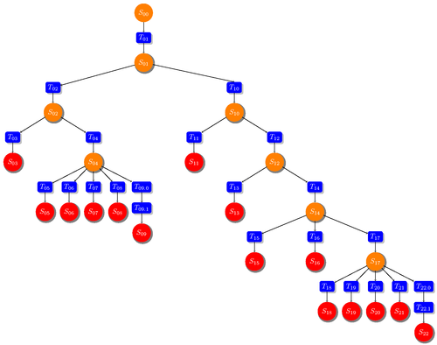
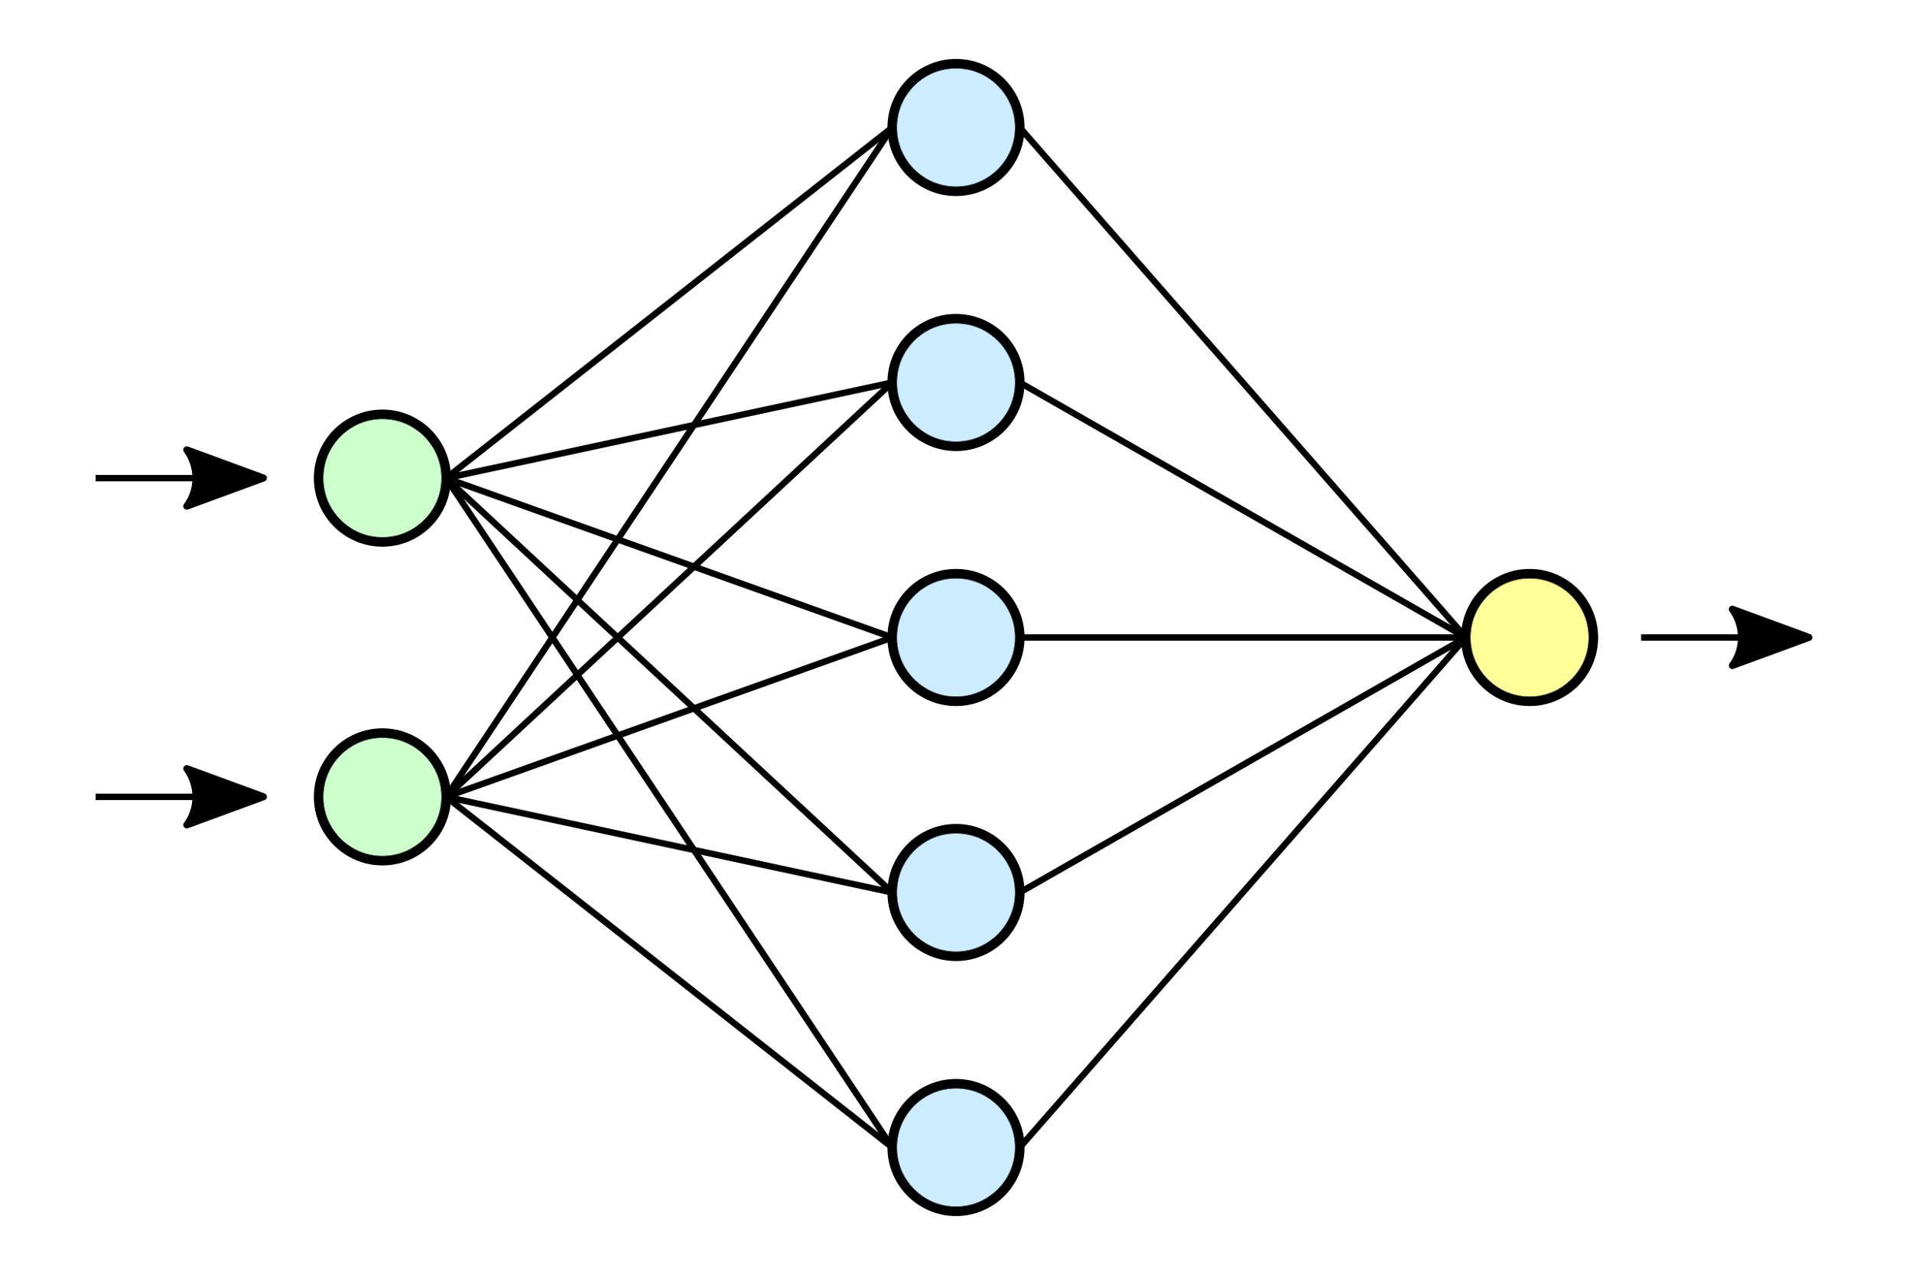
Modeling Techniques
Logistic Regression
Decision Tree
Neural Network
Notes:
Having preprocessed the data and performed descriptive analytics processes, we then generated a logistic regression model using an 80%-20% training validation split using both the original dataset and SMOTE-adjusted dataset.
We also ran a decision tree model, and concluded the optimal number of splits in JMP is 40, which results in a validation R² value of 0.64. To make the tree more accessible, the tree was pruned down from 40 splits to 10.
Our final model considered for this project is a neural network model, which we built using only the 10 variables with p-values less than 0.05 from the full logistic regression model.

Slide 5
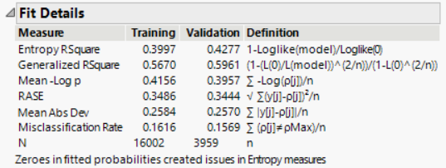
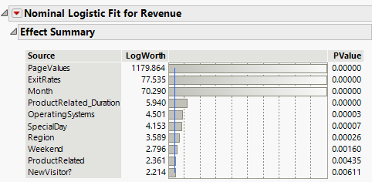
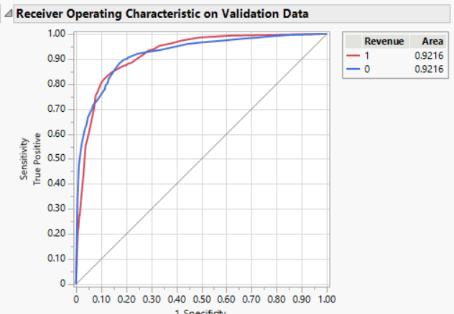
Logistic Regression Model
Reduced Model
Initial Model: After SMOTE Applied
Reduced Model: After SMOTE Applied
Created with all 18 predictor variables
Generalized RSquare: 0.60
RASE: 0.34
Misclassification Rate: 15%
AUC: 0.89
10 predictor variables (p-values less than 0.05)
Generalized RSquare: 0.60
RASE: 0.34
Misclassification Rate: 16%
AUC: 0.92
Notes:
Having preprocessed the data and performed descriptive analytics processes, we then generated a logistic regression model using an 80%-20% training validation split. We also generated a logistic regression model using the original dataset, prior to applying SMOTE to adjust for class imbalance. The model from the original dataset results in a generalized R² value of 0.39, a RASE value of 0.29, and a misclassification rate of 11%. The model predicted true positive cases with 36% accuracy and true negative cases with 98% accuracy.
The R² value from the model after adjusting for class imbalance improved by 46%. Similarly, while the specificity value of the new full logistic regression model is 92% (down by 6% compared to the original data), the sensitivity value is 76% (an increase of 111%). After building a full model from the data with SMOTE applied, we then built an alternative model using only the variables with p-values less than 0.05 from the full model. The results of this reduced model are available in Figure B-2. Using only 10 predictor variables, this model results in a generalized R² value of 0.60, a RASE value of 0.34, and a misclassification rate of 15%. Not only does the reduced model have a similar level of classification accuracy, its R² value increased by 3% over the full model, from which we can conclude that the variables excluded from the reduced model hamper predictability, rather than enhance it.

Slide 6
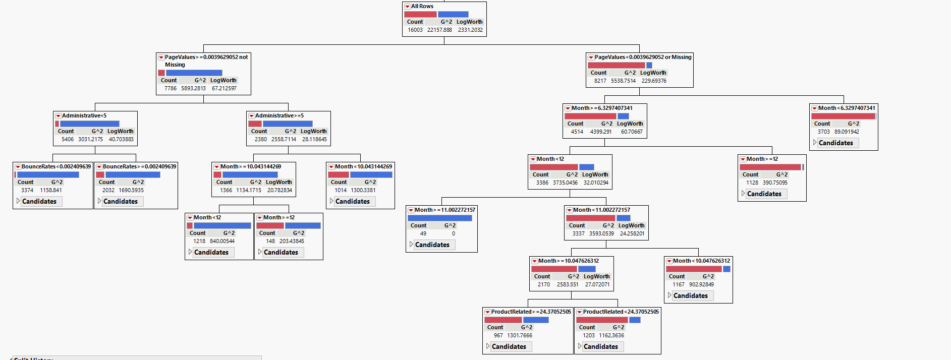
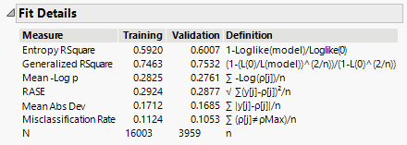
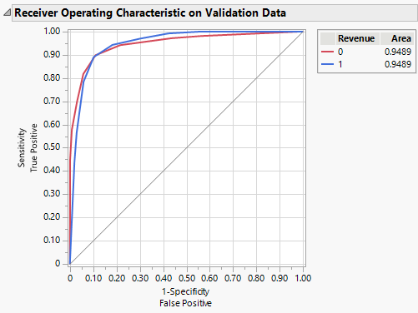
Decision-Tree Model
Optimal splits: 40
Pruned to 10 splits
Generalized RSquare: 0.75
RASE: 0.29
Misclassification Rate: 11%
AUC: 0.95
Notes:
The optimal number of splits in JMP is 40, which results in a validation R² value of 0.64. To make the tree more accessible, the tree was pruned down from 40 splits to 10. The resulting R² value is 0.6. While this is not the optimal R² value achievable in this dataset, the extra 4% improvement in R² came at the cost of 30 additional tree splits, which is only a 0.0013 per additional split, so we felt that a business leader would be more interested in a smaller tree that still has a strong predictive output. Thus, this decision tree has a generalized R² value of 0.75 (25% higher than the logistic regression model), a RASE value of 0.29, and a misclassification rate of only 11%. This decision tree has a specificity score of 89% (3% lower than the linear regression model) but a sensitivity score of 89%, which is 17% higher than that of the logistic regression model. The decision tree splits based on PageValues, Administrative, Month (6 different splits for month in total), BounceRates, and ProductRelated. Notably, Administrative and BounceRates did not meet the 0.05 significance level of the logistic regression model, but do have significance in reducing entropy in the decision tree model. PageValues and Month appear in both models. The decision tree model’s ROC curve has an AUC value of 0.95, which is nearly perfect.

Slide 7
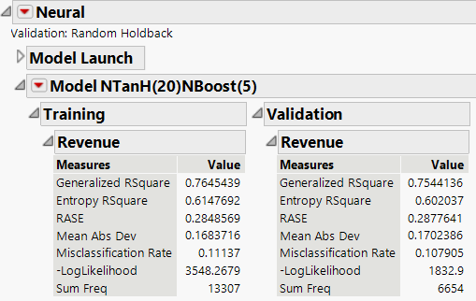
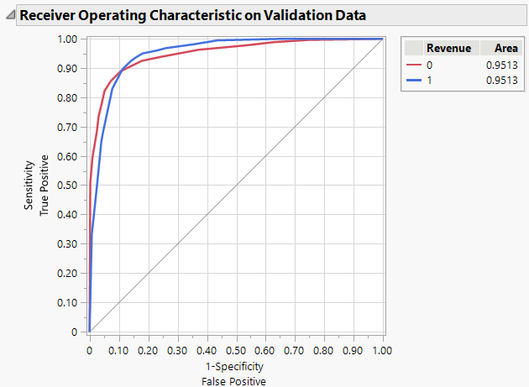
Neural Network Model
10 predictor variables (p-values less than 0.05)
Hyperbolic tangent activation function
Holdback validation method
20 units in the first hidden layer
Generalized RSquare: 0.75
RASE: 0.29
Misclassification Rate: 11%
AUC: 0.95
Notes:
Our final model considered for this project is a neural network model, which we built using only the 10 variables with p-values less than 0.05 from the full logistic regression model. When building neural network models, a common practice is to assign a number of units in the first hidden layer of the model equal to twice the number of predictor variables supplied to the model. So, the model built for this project is built using the hyperbolic tangent activation function, the holdback validation method, and 20 units in the first hidden layer of the model. The model results, found in Appendix D, indicate a generalized R² value of 0.75, a RASE of 0.28, a MAD of 0.17, and a misclassification rate of 11%. The model correctly predicts true positive cases with 90% accuracy, and true negative cases with 89% accuracy. Notably, of all the models built for this project, this is the only model that predicts true positive cases with better accuracy than true negative cases. Further, the AUC value of the ROC Curve found in Appendix D is 0.95, indicative of a nearly-perfect model for predicting true positive outcomes. While this model performs very well in predicting customer conversions using predictor variables already identified as having significance on the outcome of the target variable, the functionality of a neural network is not as readily apparent as a regression or decision tree model. This can lead to uncertainty or distrust of neural networks because these models are more difficult to understand and/or explain to other stakeholders, especially management.

Slide 8
Model Comparison
Logistic Regression
Decision Tree
Neural Network
RSquare | 0.60 | 0.75 | 0.75
RASE | 0.34 | 0.29 | 0.29
MAD | 0.26 | 0.17 | 0.17
Misclassification | 16% | 11% | 11%
Sensitivity | 76% | 89% | 90%
Specificity | 92% | 90% | 89%
AUC | 0.92 | 0.95 | 0.95
High Performing Models
Notes:
This compares the three models’ statistics altogether. The highest RSquare is a tie between Decision Tree and Neural Network models at 0.75 and the lowest misclassification rate of 11% as well as the lowest RASE of 0.29.

Slide 9
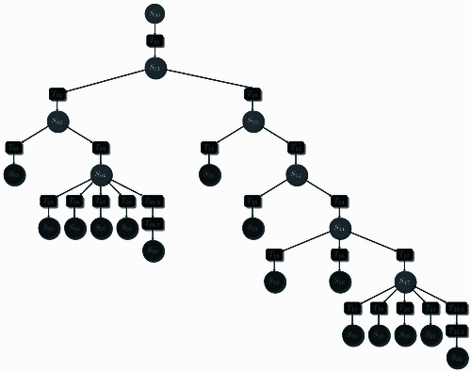

Conclusions
Our recommendation is to implement the Decision Tree model. Despite the Neural Network model providing similar evaluation results, the Decision Tree model is a better equipped model to provide real-world solutions to the business problem.
The key benefit of the Decision Tree model over the Neural Network model is its ease of interpretability. The If-Then logic of splits in a decision tree is easier to explain and interpret than the structure and function of a neural network model to the business audience.
Notes:
As mentioned in the model comparison slide, the neural network and decision tree model have similar evaluation results. However, the deciding factor also included the factor of which model would easily be understood by the audience. Hence, the decision tree model is chosen, as it is easier to interpret and visually understand when compared to a neural network.

